Slide 1
Managing HTS Data Management eTools for Logbook Data Management and Analysis
Laboratory Data Monitoring Team
International Branch, CDC Atlanta
RTCQI Best Practices Workshop-Western Hemisphere

Slide 2
Agenda
Overview of eTools for Logbook Data Analysis
Roles and Responsibilities of Stakeholders
Data Flow and Management Overview
Integration with Data Management Tools
Live Demonstration of the Data Tool

Slide 3
Overview
The HTS Register is a crucial tool in managing and delivering HIV Testing Services (HTS), providing a comprehensive system for documenting test results and follow-up actions.
Logbook e-Tools streamline the analysis process for monitoring the testing quality.
A user-friendly tool that facilitates site access for entering summary data for reporting and analysis.

Slide 4
Stakeholders and Their Roles
Testing Sites
Utilize the tool to input page-level summary data on a monthly basis for statistical analysis.
Each testing point has individual access to its data and analysis.
Quality Manager
Conducts thorough reviews of all reported data.
Utilizes analytical tools to assess agreement rates, test kit usage, invalid test results, and percentage positive.
Provides reports to support testing sites and facilitate decision-making.
Performs analyses at both the district and national levels with controlled access.

Slide 5



Data Flow and Management
National Level
District/Province Level
Facility Level
Facility Level

Slide 6
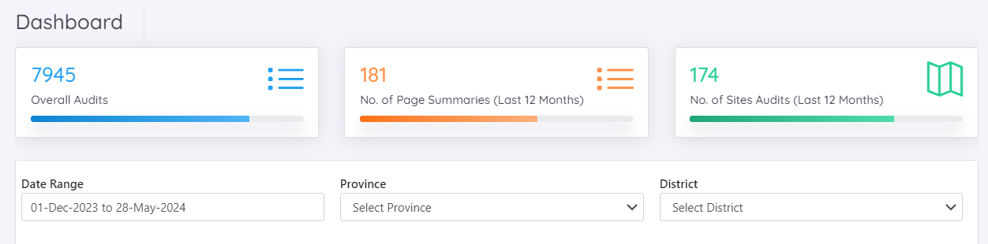
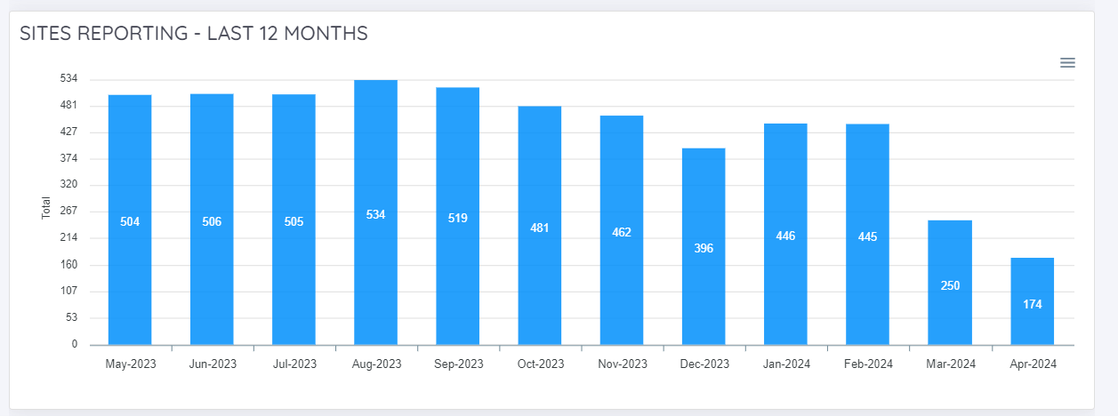

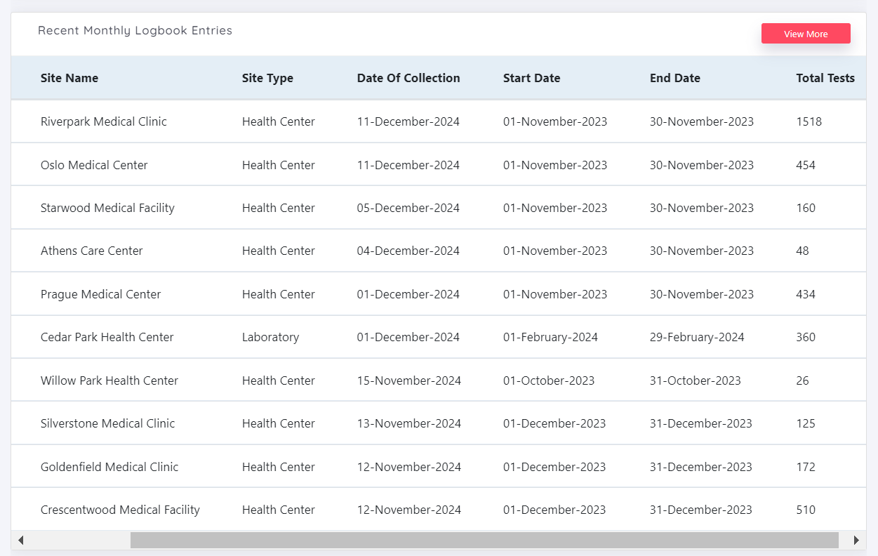
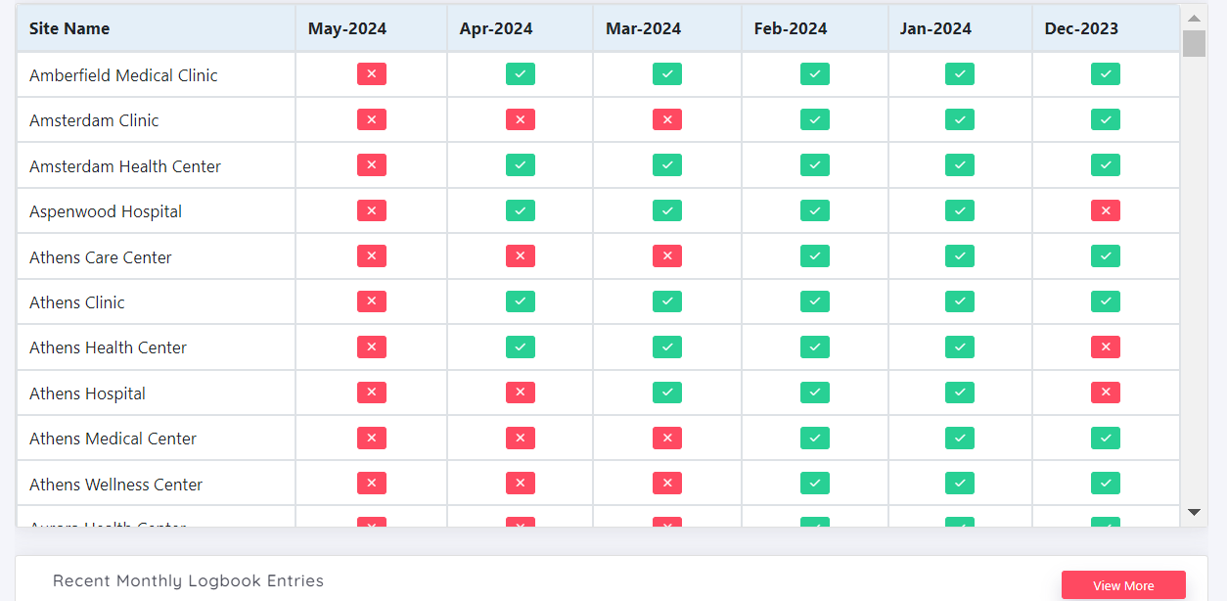
Dashboard

Slide 7
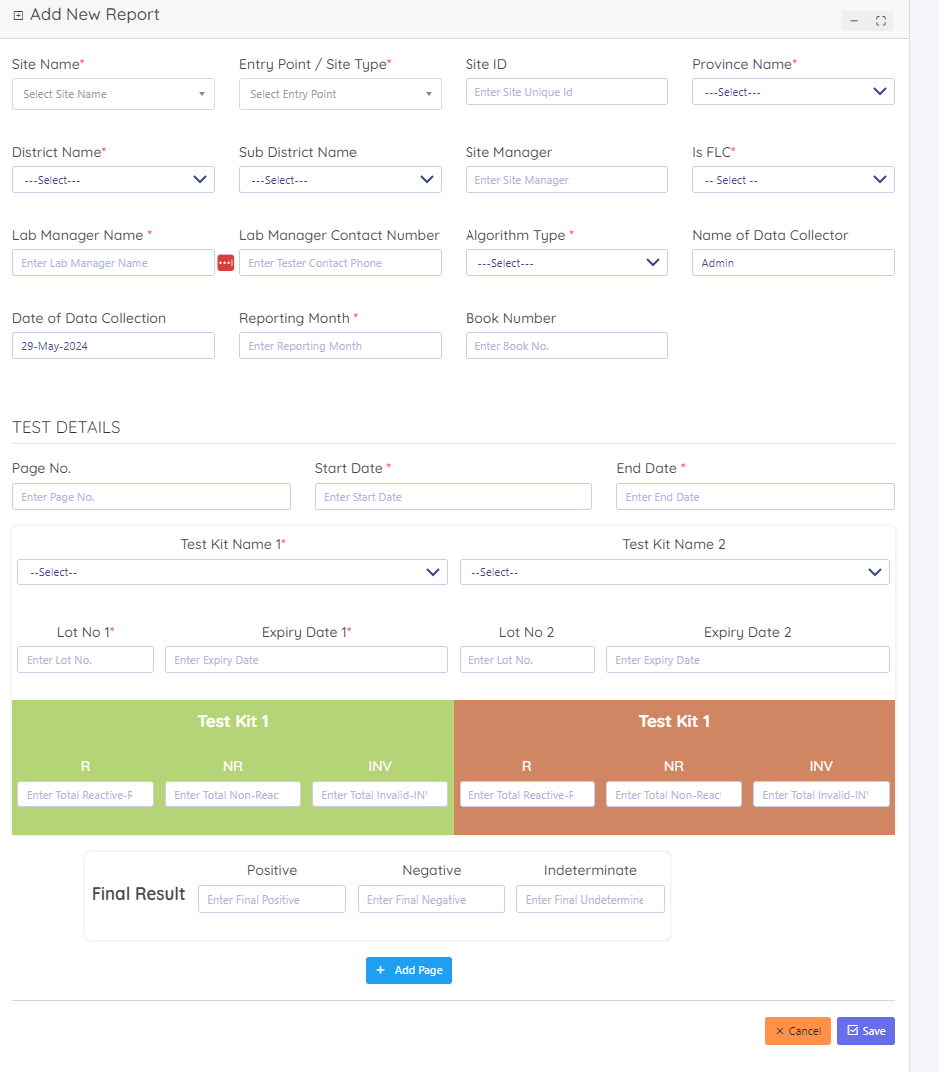
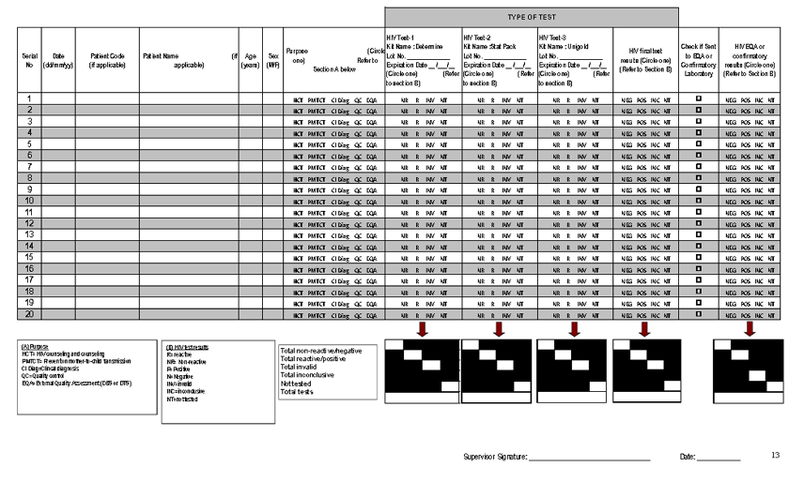
Report Logbook Data

Slide 8
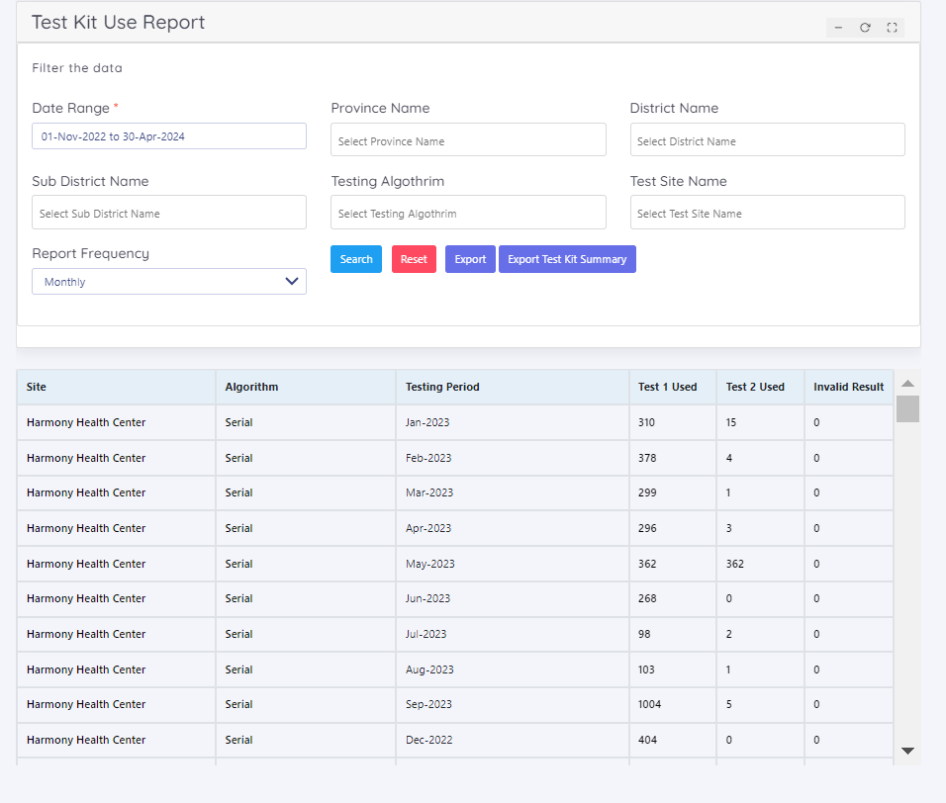
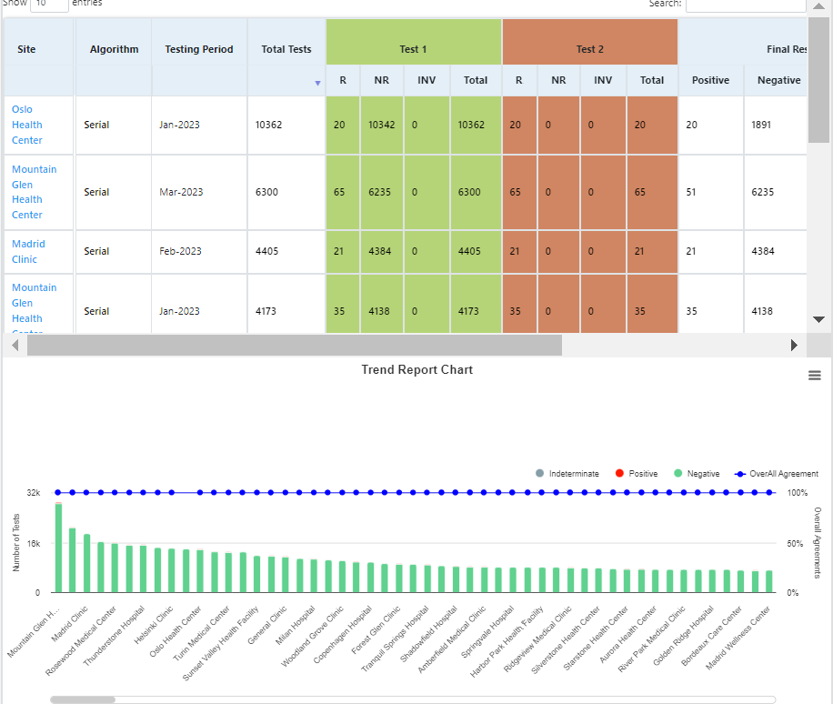
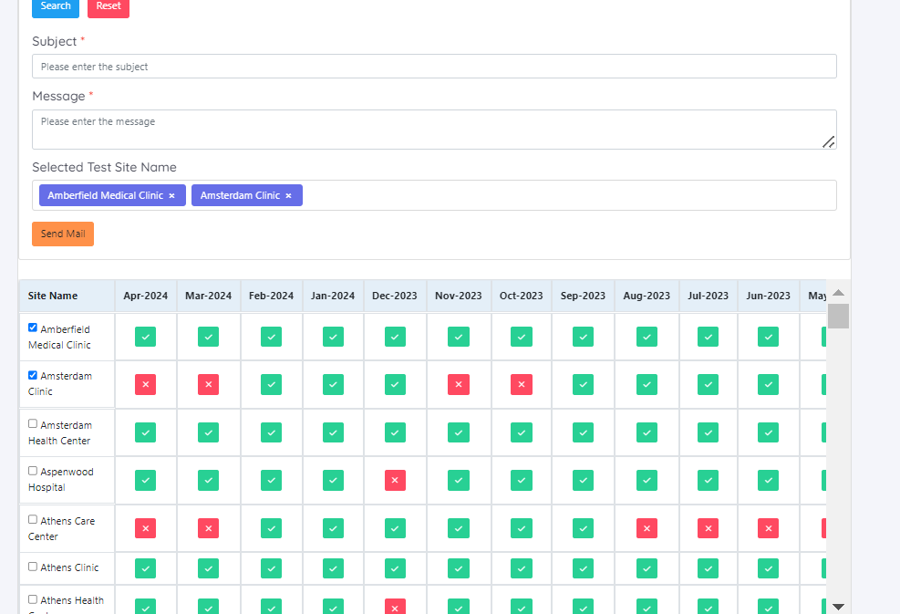
Data Analysis

Slide 9
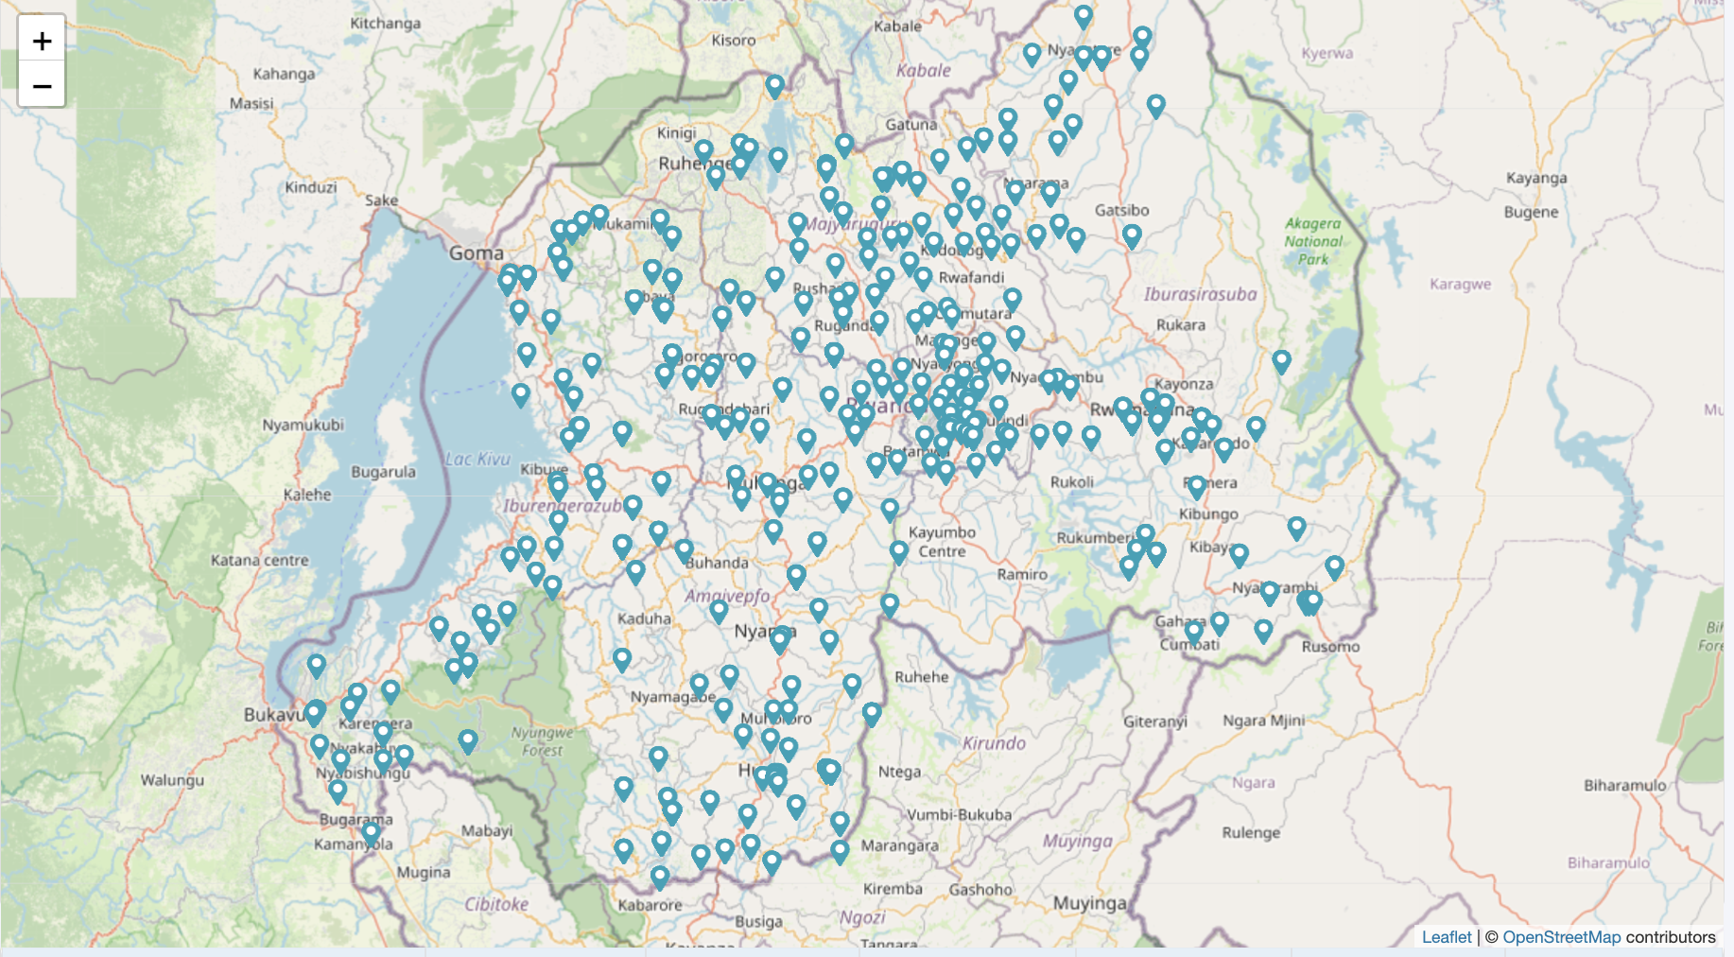

Slide 10
Implementation Considerations
Project Management: Oversee project execution to ensure timely completion and adherence to objectives.
Tool Selection: Choose the appropriate tool tailored to the country's needs.
User Training: Conduct comprehensive training for end users to ensure effective tool usage.
Implementation: Implement the tool in a stepwise manner to manage complexity.
Data Management: Utilize the Ministry of Health's data servers or other approved service providers for tool implementation.
Site Identification: Standardize site ID usage across SPI-RRT and other tools for consistency.
Reporting: Delegate monthly reporting tasks through eTools to maintain regular updates.
Feedback Mechanism: Utilize ECO sessions to gather and integrate feedback from users.
Data Integration: Connect data to the national PEPFAR reporting system and assess integration with platforms like DHIS2 for broader usability.

Slide 11
Effectiveness and Integration
Efficiency: Reduces manual effort and time required for data collection.
Accuracy: Ensures timeliness and precision in data collection.
Support for Testers: Provides quality managers with timely information to predict training needs and monitor testing quality.
Integration with other Systems: Includes tester certifications and proficiency testing linkages to support quality assurance.

Slide 12
Ready to Collaborate and Enhance?
Engage:
Please feel free to ask any questions and provide feedback
Share your thoughts on how we can improve or adapt these tools for better efficiency.
Plan Next Steps:
We are here to support you every step of the way. Let’s schedule a follow-up to discuss specific implementation strategies.
Stay Connected:
For further inquiries or additional information, don’t hesitate to contact me.
Email: app0@cdc.gov
Let's dive deeper into any aspects you're interested. Please visit us at IT Booth.

Slide 13
Demo -- Scenario Overview
Location and Partners:
Country: Healthland
District: Medville
Partners: HealthPartners Global
eTool - Logbook Overview:
Responsibility: The National Reference Laboratory oversees the collection and analysis of all testing data.
Site Reporting: HIV rapid testing sites are required to submit monthly aggregate data to the logbook.
Event Example:
Collaboration: The National Reference Laboratory collaborates with HealthPartners Global to:
Collect monthly aggregate data.
Conduct data analysis.
Provide feedback to testing sites.
eTool Usage:
Role of HealthPartners Global: Assists various testing sites in reporting monthly aggregate data from the HIV Register.
Review and Feedback: The National Reference Laboratory analyzes the monthly data and offers feedback.
Integration Highlights:
Tester Certification Linkage: Demonstrates how the tool integrates tester certification processes with individual tester certifications, enhancing oversight and quality.
Proficiency Testing (PT) Linkage: Ensures direct integration of PT results with site audits to maintain testing quality.
SPIRRT Linkage: Establishes a connection between the testing site and the SPII RT checklist to streamline compliance and reporting.
Demo Objectives:
This demonstration will guide you through the full cycle of data management from collection to analysis.
Includes a dashboard demonstration tailored to the outlined scenario, highlighting efficient data entry, management, and reporting capabilities.

Slide 14
Thank You

